Slide 1
Do Now
Quick refresher quiz on iLearn
370.S19.Lesson27.Quiz
password: pizzabagel
Homework 5 resubmissions due Thursday 5/2/19
Homework 6 due Tuesday 5/7/19
Final exam is Tuesday 5/14/19*

Slide 2
CST 370 – ADVANCED ALGORITHMS
Dynamic Programming II

Slide 3
Objectives
You will be able to…
Recall the definitions of optimal sub-structure and overlapping sub-problems.
Understand the use case of dynamic programming to improve the time complexity of recursive algorithms that have those.
Differentiate between memoization (top-down or recursive DP) & tabulation (bottom-up or linear DP).
Identify pros and cons of top-down & bottom-up dynamic programming.
Use memoization & tabulation to solve problems.

Slide 4

Sub Problems
Problems that can be broken down into smaller versions of the same problem are said to contain sub problems.
fib(3)
fib(2)
fib(1)
fib(1)
fib(0)

Slide 5
Sub Problems
The sub-problems combine to solve the original problem.
int fib(int n) {
if (n == 0 || n == 1) {
return n;
}
return fib(n – 1) + fib (n – 2);
}
fib(3)
fib(2)
fib(1)
fib(1)
fib(0)

Slide 6
Optimal Sub-structure
The sub-problems combine to solve the original problem. This property is called Optimal Sub-Structure.
int fib(int n) {
if (n == 0 || n == 1) {
return n;
}
return fib(n – 1) + fib (n – 2);
}
fib(3)
fib(2)
fib(1)
fib(1)
fib(0)

Slide 7
Overlapping Sub-Problems
The overlapping sub-problems property means that the same sub-problems are being solved multiple times.
fib(5)
fib(4)
fib(3)
fib(3)
fib(2)
fib(2)
fib(1)
fib(2)
fib(1)
fib(1)
fib(0)
fib(1)
fib(0)
fib(1)
fib(0)

Slide 8
Dynamic Programming
Identifying Dynamic Programming Problems.
Typically most DP problems involve one of the following:
Finding the Maximum or Minimum of something
Optimizing (finding the best/worst) of something.
Counting the total number of something.
Notes:
If a problem exhibits these things, you can “consider” using dynamic programming, that doesn’t mean DP is always the right way to go. Maybe you’re trying to find the shortest path in a maze. We can use other algorithms like BFS/DFS for that.

Slide 9
Dynamic Programming
Problems that exhibit both Optimal Sub-Structure and Overlapping Sub-Problems properties are great candidates for solving with a dynamic programming algorithm.
Notes:
https://www.geeksforgeeks.org/dynamic-programming-set-1/

Slide 10
Dynamic Programming
Dynamic programming (DP for short) is a problem-solving technique where we store the solutions to overlapping sub-problems to avoid computing them again.
Dynamic programming explicitly trades of Space complexity for Time complexity.
Notes:
https://www.geeksforgeeks.org/dynamic-programming-set-1/

Slide 11
Dynamic Programming
Trade-off Example
There are 2^{n} calls to fib but only n unique calls!
Complexity of naive fibonacci:
Time: O(2^{n})
Space: O(1)
fib(5)
fib(4)
fib(3)
fib(3)
fib(2)
fib(2)
fib(1)
fib(2)
fib(1)
fib(1)
fib(0)
fib(1)
fib(0)
fib(1)
fib(0)
Notes:
If a problem exhibits these things, you can “consider” using dynamic programming, that doesn’t mean DP is always the right way to go. Maybe you’re trying to find the shortest path in a maze. We can use other algorithms like BFS/DFS for that.

Slide 12
Dynamic Programming
Trade-off Example
There are 2^{n} calls to fib but only n unique calls!
If we can save the results of the unique fib calls, we can solve the problem in O(n) time!
fib(5)
fib(4)
fib(3)
fib(3)
fib(2)
fib(2)
fib(1)
fib(2)
fib(1)
fib(1)
fib(0)
fib(1)
fib(0)
fib(1)
fib(0)
Notes:
If a problem exhibits these things, you can “consider” using dynamic programming, that doesn’t mean DP is always the right way to go. Maybe you’re trying to find the shortest path in a maze. We can use other algorithms like BFS/DFS for that.

Slide 13
Dynamic Programming
Trade-off Example
There are 2^{n} calls to fib but only n unique calls!
If we can save the results of the unique fib calls, we can solve the problem in O(n) time!
fib(5)
fib(4)
fib(3)
fib(3)
fib(2)
fib(2)
fib(1)
fib(2)
fib(1)
fib(1)
fib(0)
fib(1)
fib(0)
fib(1)
fib(0)
Notes:
If a problem exhibits these things, you can “consider” using dynamic programming, that doesn’t mean DP is always the right way to go. Maybe you’re trying to find the shortest path in a maze. We can use other algorithms like BFS/DFS for that.

Slide 14
Dynamic Programming
Trade-off Example
There are 2^{n} calls to fib but only n unique calls!
Complexity of DP fibonacci:
Time: O(n)
Space: O(n)
fib(5)
fib(4)
fib(3)
fib(3)
fib(2)
fib(2)
fib(1)
fib(2)
fib(1)
fib(1)
fib(0)
fib(1)
fib(0)
fib(1)
fib(0)
Notes:
If a problem exhibits these things, you can “consider” using dynamic programming, that doesn’t mean DP is always the right way to go. Maybe you’re trying to find the shortest path in a maze. We can use other algorithms like BFS/DFS for that.

Slide 15
Dynamic Programming
How To
Dynamic programming can be achieved recursively or iteratively.
Recursive DP is called memoization or top-down DP.
Iterative DP is called tabulation or bottom-up DP.
Notes:
https://www.geeksforgeeks.org/dynamic-programming-set-1/

Slide 16
Dynamic Programming
Memoization (Top-Down DP)
Called “top-down” because we start at the largest sub-problem and work our way down to the smallest sub-problem.
Notes:
https://www.geeksforgeeks.org/dynamic-programming-set-1/

Slide 17
Dynamic Programming
Tabulation (Bottom-Up DP)
Called “bottom-up” because we start at the smallest sub-problem and work our way up to the largest sub-problem.
Notes:
https://www.geeksforgeeks.org/dynamic-programming-set-1/

Slide 18
Coding Example
Consider the Fibonacci Sequence. Here’s code that computes the nth Fibonacci number.
int fib(int n) {
if (n == 0 || n == 1) {
return n;
}
return fib(n – 1) + fib (n – 2);
}

Slide 19
Coding Example
Consider the Fibonacci Sequence. Implement a program to find the n^{th} Fibonacci number with memoization and tabulation.
https://repl.it/@dsyang/DynamicProgramming

Slide 20
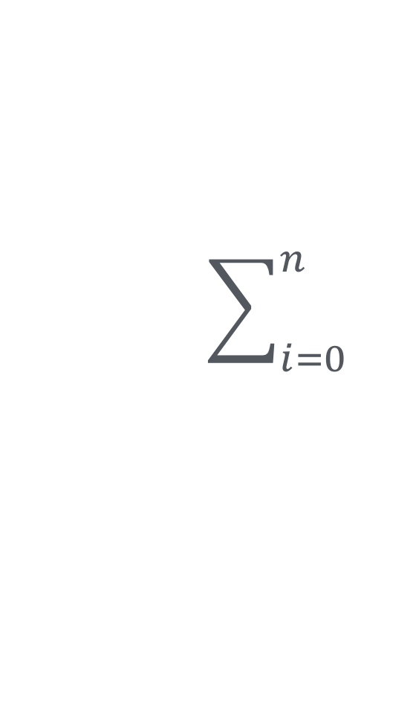
Now It’s your turn!
Catalan Numbers
The Catalan numbers, like the Fibonacci numbers, are a sequence of natural numbers. The first Catalan number is defined C₀ = 1 and thereafter C_{n+1} = C_{i}C_{n-i}.
For example,
C₁ = C₀C₀ = 1 * 1 = 1
C₂ = C₀C₁ + C₁C₀ = 1 * 1 + 1 * 1 = 2
C₃ = C₀C₂ + C₁C₁ + C₂C₀ = 1 * 2 + 1 * 1 + 2 * 1 = 5
C₄ = C₀C₃ + C₁C₂ + C₂C₁ + C₃C₀ = 1 * 5 + 1 * 2 + 2 * 1 + 5 * 1 = 14

Slide 21
Lab
Catalan Numbers
long catalan(int n) {
if (n == 0) { return 1;}
long cat_number = 0;
for(int i = 0; i < n; i++) {
cat_number += catalan(i)*catalan((n-1)-i);
}
return cat_number;
}

Slide 22
Dynamic Programming
Catalan Numbers Example
Implement a program to find the n^{th} Catalan number. Do it with each of memoization and tabulation.

Slide 23
Dynamic Programming
Tabulation versus Memoization
 | Memoization | Tabulation
Advantages | Code is very similar to non-DP recursive solution Only compute sub-problems you need to solve the input problem | Iterative approach is often considered easier to understand and debug
Disadvantages | Recursive overhead (might cause a stack overflow on large inputs) | Compute all sub-problems, not just those that are necessary to solve the input problem
Notes:
https://www.geeksforgeeks.org/dynamic-programming-set-1/

Slide 24
Dynamic Programming
How to break a problem down
Identify that you can use DP for the problem – i.e., that it has the overlapping sub-problems and optimal sub-structure problems. Often DP problems ask you to minimize or maximize something or count possibilities under certain conditions.

Slide 25
Dynamic Programming
How to break a problem down
Identify that you can use DP for the problem – i.e., that it has the overlapping sub-problems and optimal sub-structure problems. Often DP problems ask you to minimize or maximize something or count possibilities under certain conditions.
Determine the state. The state is a collection of parameters that uniquely identify a sub-problem. The state will used to store and retrieve results.

Slide 26
Dynamic Programming
How to break a problem down
Identify that you can use DP for the problem – i.e., that it has the overlapping sub-problems and optimal sub-structure problems. Often DP problems ask you to minimize or maximize something or count possibilities under certain conditions.
Determine the state. The state is a collection of parameters that uniquely identify a sub-problem. The state will used to store and retrieve results.
Determine the relationship between states; i.e., how to find a state from smaller states.

Slide 27
Coding Example
The Knapsack Problem
Suppose we have n items and a knapsack. Each item has a monetary value and a physical weight. (These are stored in arrays of integers where corresponding indices indicate the value and weight for the same number.) We want to find the maximum value of objects we can carry without exceeding the weight limit w of the knapsack.

Slide 28
Coding Example
The Knapsack Problem
Mark Zuckerberg says he’ll buy you anything from Best Buy as long as you can fit it in a shopping cart. The cart can hold at most x lbs. how do you pick the most expensive things to fit into the cart and get for free?

Slide 29
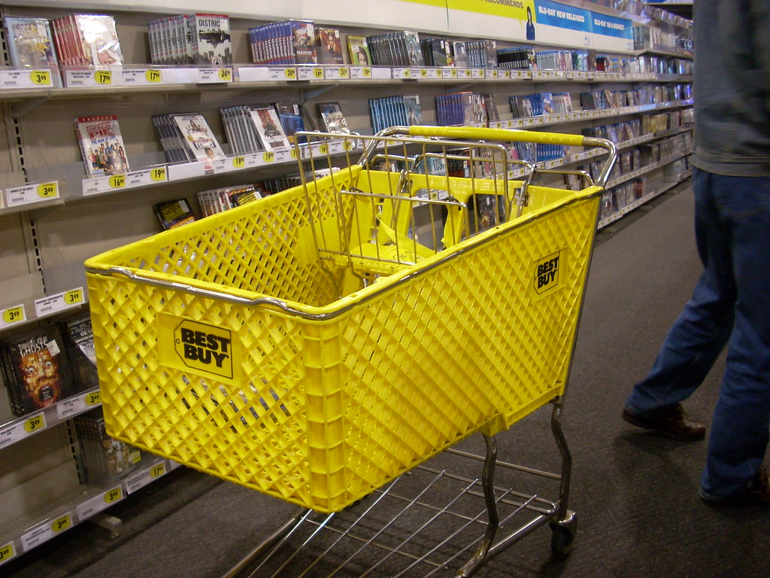
Coding Example
The Knapsack Problem
num_items = 4
value[] = [5, 4, 3, 2]
weights[] = [4, 3, 2, 1]
cart_limit = 6

Slide 30
Coding Example
The Knapsack Problem
Break it into sub-problems.
hint: A given item, can either be in the cart or not.
https://repl.it/@dsyang/DynamicProgramming

